Slide 1
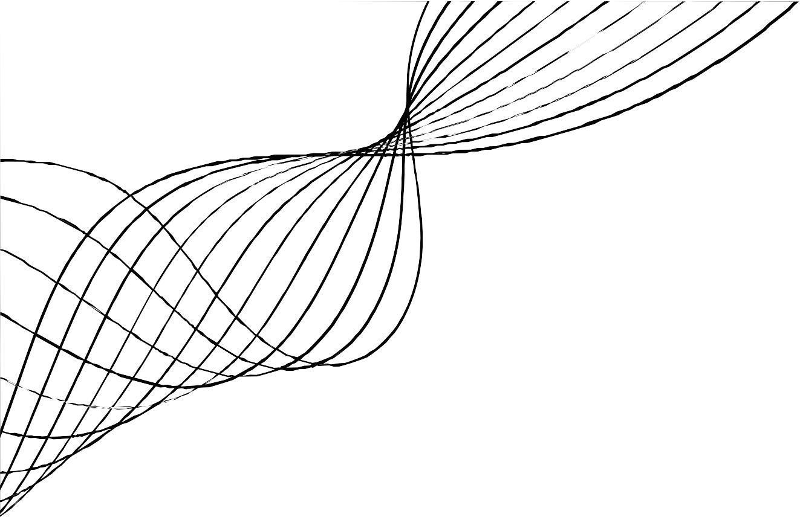
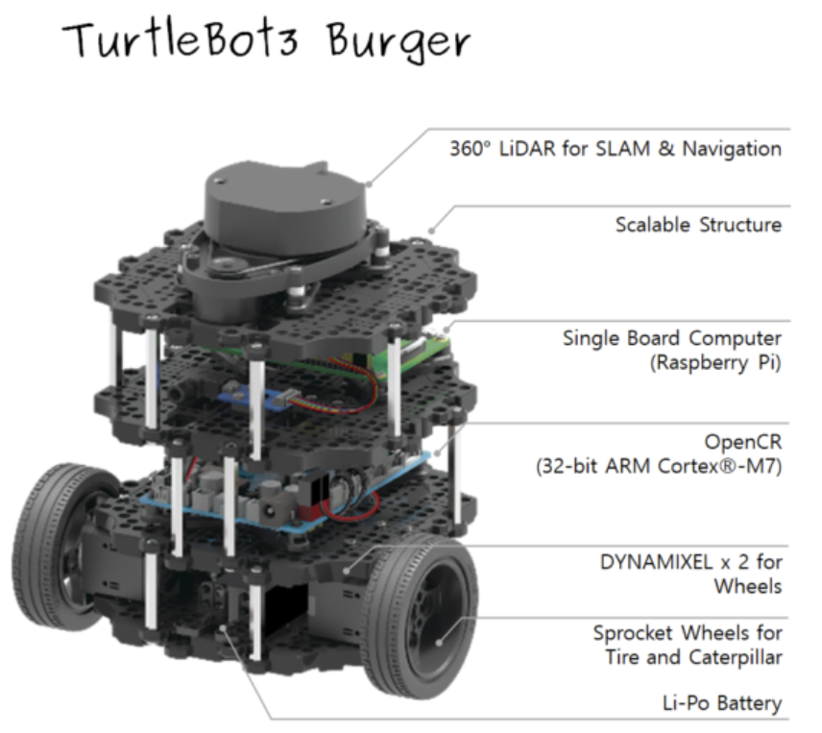
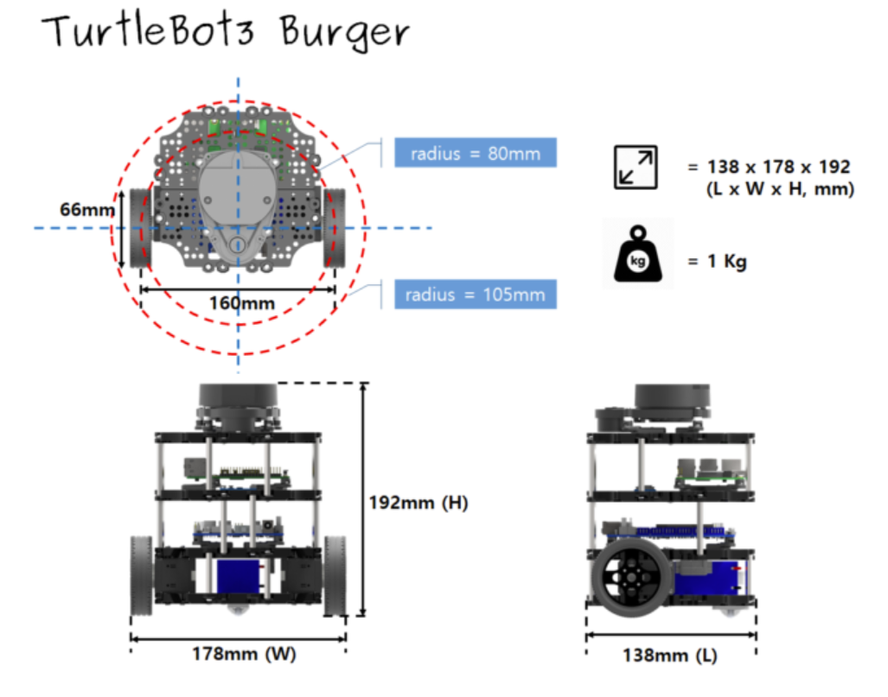
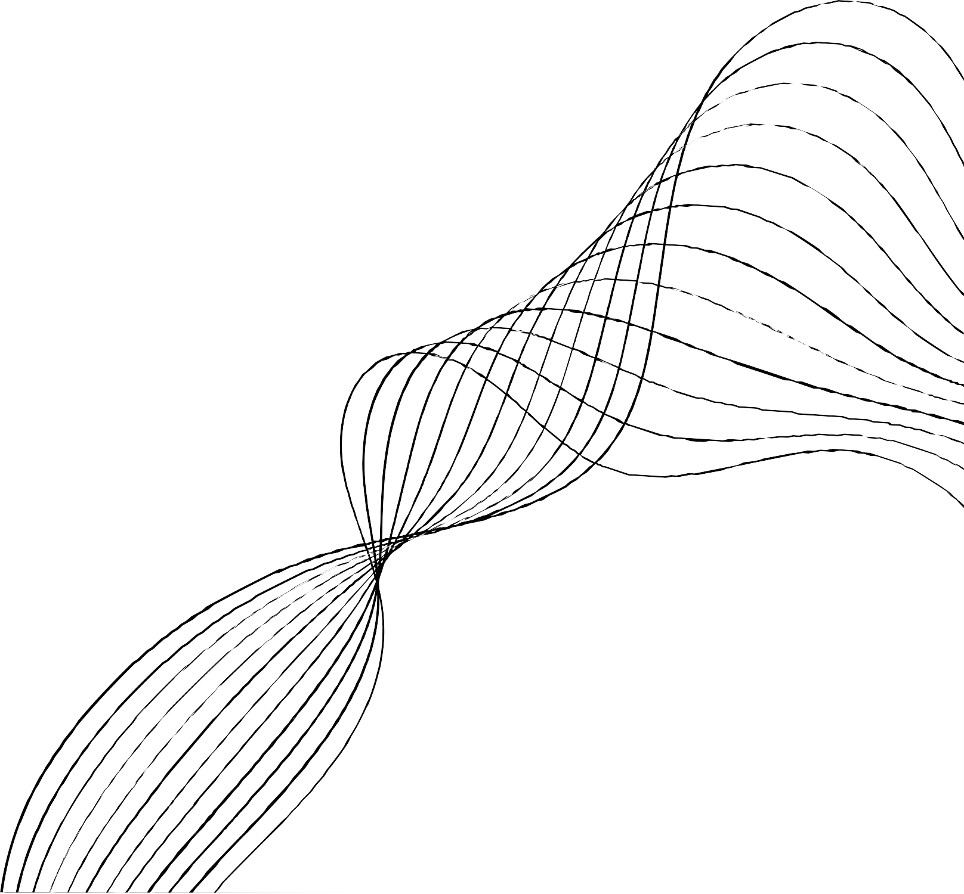
Hardware
360˚ LDS-02 LiDAR
Raspberry Pi (Single Board Computer)
OpenCR
IMU Unit
12V Li-Po battery
Remote PC (Windows)

Slide 2


Software
Ubuntu 20.04 is used as the operating system on the Oracle Virtual Machine.
ROS Noetic, running on Ubuntu, includes packages specifically for the TurtleBot3 Burger.
Gazebo is used to run simulation experiments.
Rviz, a 3D visualization tool, is used in both simulated and actual experiments.
The combination of ROS and Gazebo speeds up the move from simulation to real deployment, making sure that what’s developed in Gazebo can be directly applied to the actual TurtleBot3 Burger robots.

Slide 3


Algorithms
SLAM
The ROS Gmapping package is utilized for SLAM to generate a map of the surroundings.
Localization
Utilization of AMCL: Adaptive Monte Carlo Localization (AMCL) is utilized to determine the robot's precise location, i.e. position and orientation.
Particle Filter Application: A particle filter is deployed within a predefined map to enhance the robot's navigation accuracy.
Navigation
Global Planner: Utilizes the NavfnROS planner implementing Dijkstra’s algorithm to create a route from the robot's current location to its destination across the entire known map.
Local Planner: Employs the Dynamic Window Approach Planner (DWA) which dynamically updates the robot's path in real-time based on the global plan and changes in the local environment.

Slide 4

Challenges and Solutions
Challenge 1: Inaccurate Mapping at Higher Speeds
Solution: Reduced operational speed to 0.1 m/s.
Justification: Slower speeds enhance sensor data accuracy and improve map fidelity.
Challenge 2: Map Degradation from Repeated Area Coverage
Solution: Implemented a pre-planned navigation route.
Justification: Prevents redundant data collection and ensures more consistent maps.

Slide 5
Strengths and Limitations
Strengths
User-friendly Setup: Utilizes ROS and Rviz for accessible system management.
Cost-effective: Uses 2D LiDAR, balancing cost and performance.
Effective 2D Mapping: Utilizes ROS Gmapping and 2D LiDAR for accurate indoor mapping.
Limitations
Limited Env. Awareness: Restricted by 2D LiDAR's capabilities in complex environments.
Limited Interaction Capabilities: Lacks advanced human-robot interaction features.
Energy Efficiency Concerns: Limited operational time due to battery constraints.

Slide 6
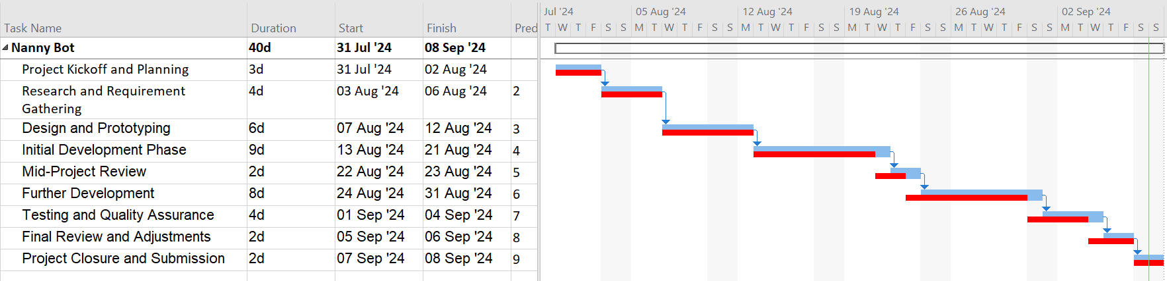
Time Management
: Planned
: Actual

